Slide 1
Deaf Hub at RIT: A Resource for All of Us
Notes:
Shamsi

Slide 2
Welcome from Our Moderator Dr. Bonnie Jacob, Director of Science Mentoring and Bridges Program Director
Accessibility practices
Q&A
Pausing practice
Session agenda
Notes:
Bonnie
12:02-12:10 — welcome and expectation setting
Today, will discuss making meeting more accessible.
Chat is off because it is noisy and disruptive for screen readers.
Q&A tab is on! Share your questions and we will get to as many as we can during Q&A.
Practice a moment of silence? To get used to extra pauses.

Slide 3
Introductions
Notes:
12:10-12:20 — Introductions (2 mins max per person, keep in mind introductions already done in preview video)
Bonnie
Camille
Hannah
Carrie
Dyl
Liz

Slide 4
Hannah’s Story
Notes:
Bonnie – briefly introduce Hannah as a Bridges student

Slide 5
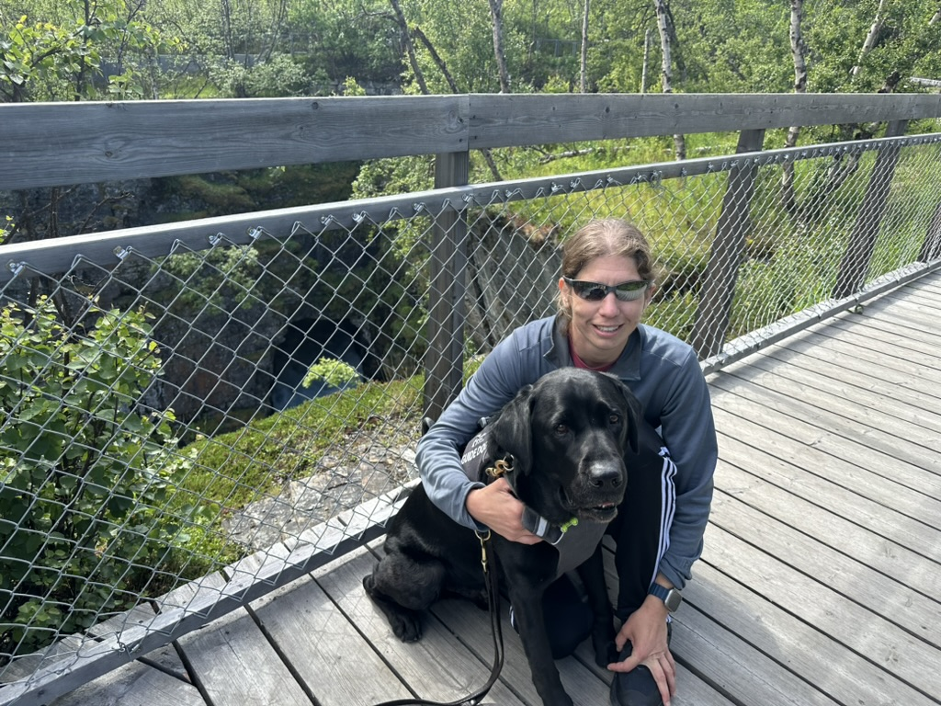
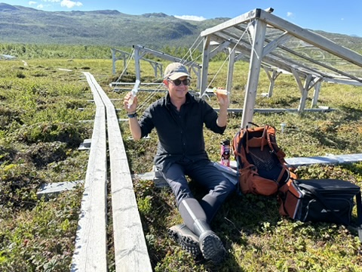
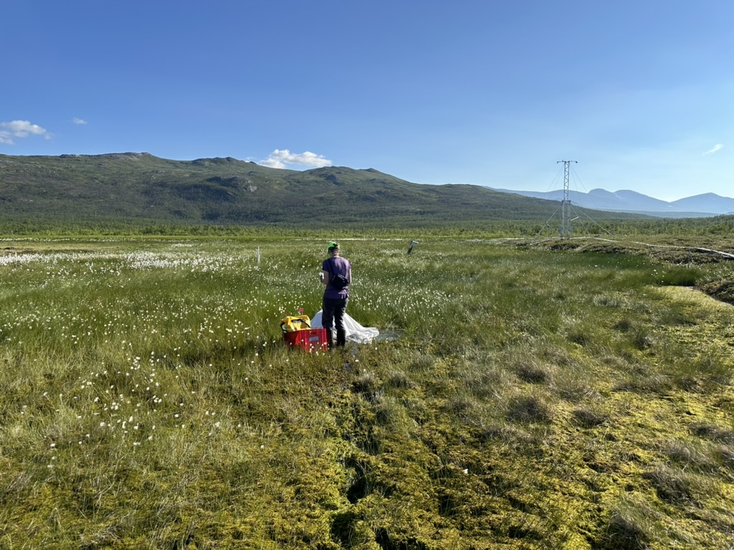
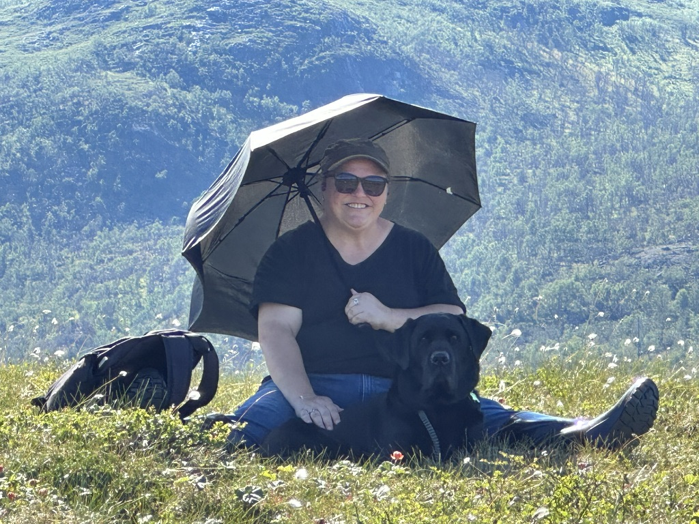
Hannah’s Story Photos
Notes:
12:20-12:30 — Hannah’s story
How did you realize you wanted to become a scientist?
What barriers have you faced in your journey?
How did you overcome these barriers?
Emphasize connection with deaf hub and how it has supported me in my journey
Can you tell us how ‘Deafblind gain’ works?

Slide 6
Five Minute Break
Notes:
Bonnie – introduce break
5 minutes (12:30-12:35)

Slide 7
What is Deaf Hub?
Notes:
Bonnie – introduce Camille for this section
12:35-12:45 — What is Deaf Hub?
Have some slides about different programs and research labs
Carrie: include slide on how RISE and Bridges programs have helped her be a mentor to Hannah
Mention resources available to everyone, and open for people to reach out.

Slide 8
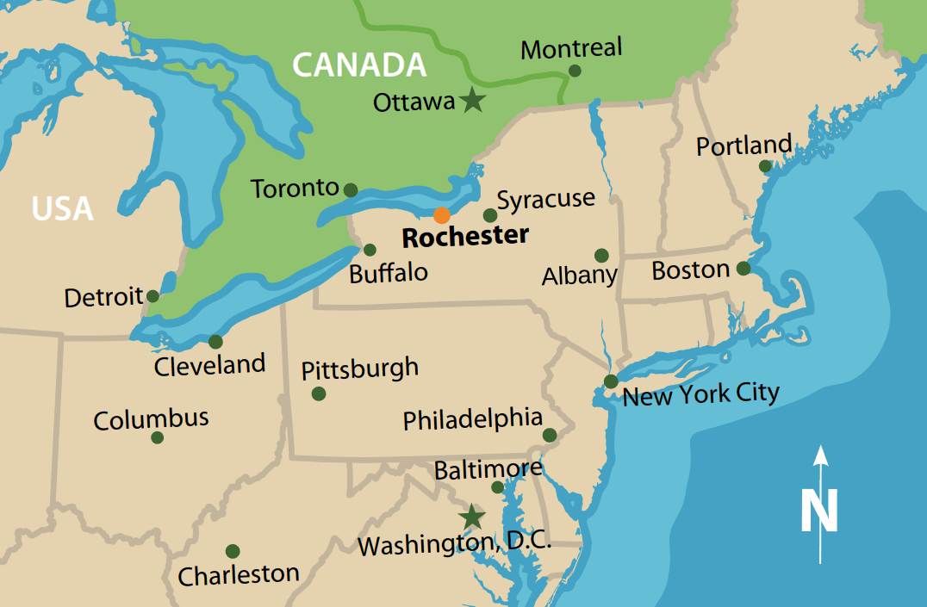
Deaf Health Care and Biomedical Science Hub (2022)
Statement
Deaf and hard-of-hearing (DHH) individuals are underrepresented in health care and biomedical science careers:
Building pathways to health care careers for the DHH community¹
Building a community for deaf scientists²
Solution:
Rochester has unique resources to support DHH towards employment in health care and biomedical science careers:
Middle and high school students
Undergraduate and graduate students
Post-doctoral fellows and early-career professionals
Citations
Task force on health care careers for the D/HH community, 2012
Buckley, Smith, Decaro, Barnett, & Dewhurst, 2017
Notes:
Camille
2 minutes

Slide 9
RIT Deaf Health Care and Biomedical Science Hub
Health Care Careers Exploration Program (HCCEP)
Undergraduate Research Training Initiative for Scientific Enhancement (U-RISE)
Rochester Postdoc Partnership (RPP)
Academia
Mentor-Supported Shadowing Program (MSSP)
Rochester Bridges to the Doctorate (Bridges)
Deaf Health Laboratory (DHL)
XR Accessibility Solutions Laboratory
(XR-ASL)
Research
Research and Education on Accessible Communication in Health Care (REACH) Laboratory
Summer Healthcare Academic Research Program (SHARP)
Notes:
Camille
3 minutes

Slide 10
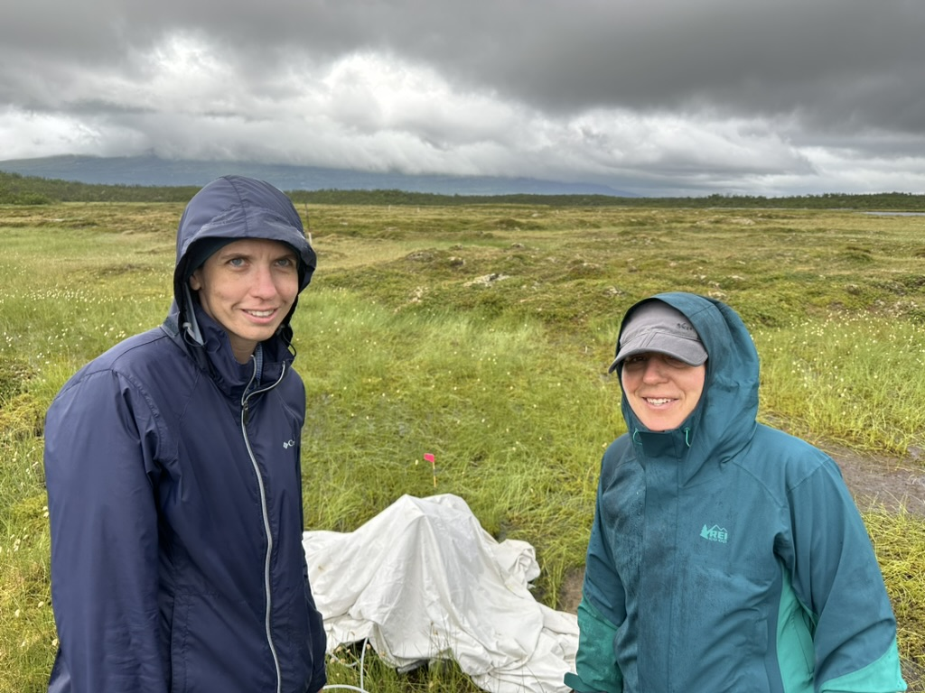
Carrie’s Story: U-RISE and Bridges
Notes:
Carrie
5 min

Slide 11
Deaf Hub in Action
Notes:
Bonnie – emphasize these are meant to act as examples for others to take back to their institutions and possibly build their own programs, then introduce Dyl
12:45-12:55 — Deaf Hub in action
Play videos
Address how others can provide or seek out similar opportunities
What are the key features of an inclusive environment?

Slide 12
Sample Program Events
Deaf Hub Explores Perspectives (DHEP)
Professional Development
Deaf Scientist Time
Poster sessions and presentations at program, college, university, and conference levels
Notes:
Dyl – 1 minute

Slide 13
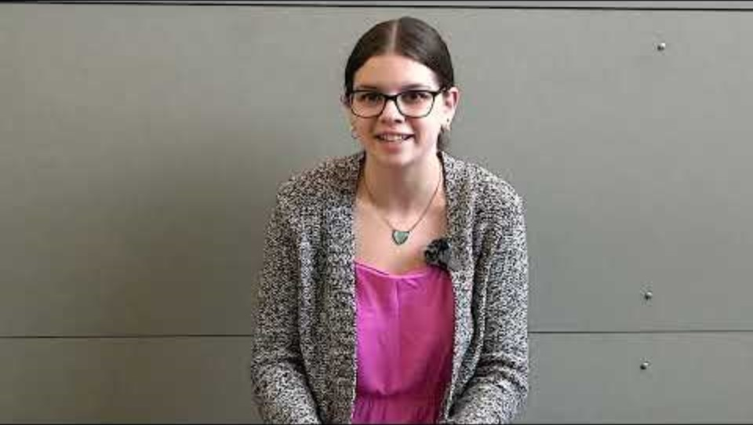
SHARP 2024 Reflections Video
Notes:
Dyl - Stop video at 1:38 (end of Alison’s part)

Slide 14
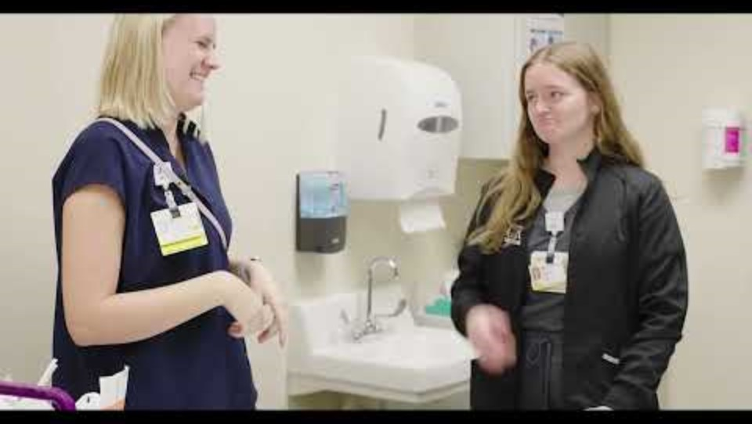
Mentor-Supported Shadowing Program
Notes:
Liz - 3 min video

Slide 15
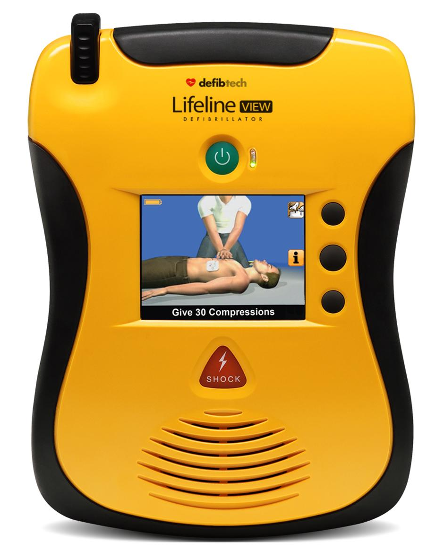
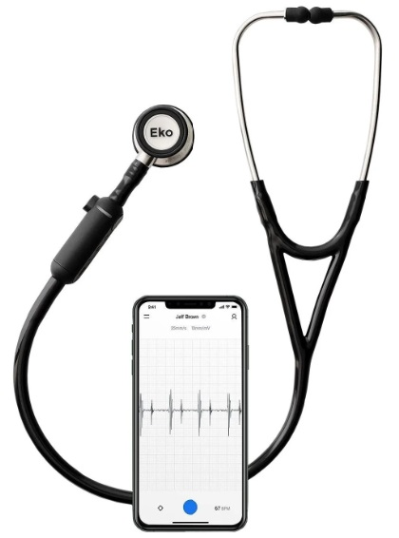
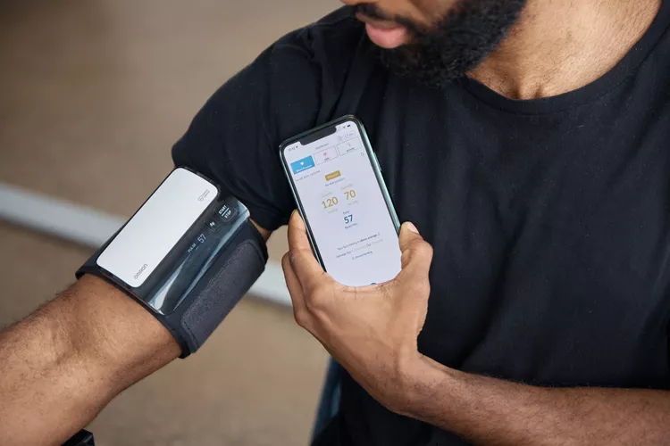
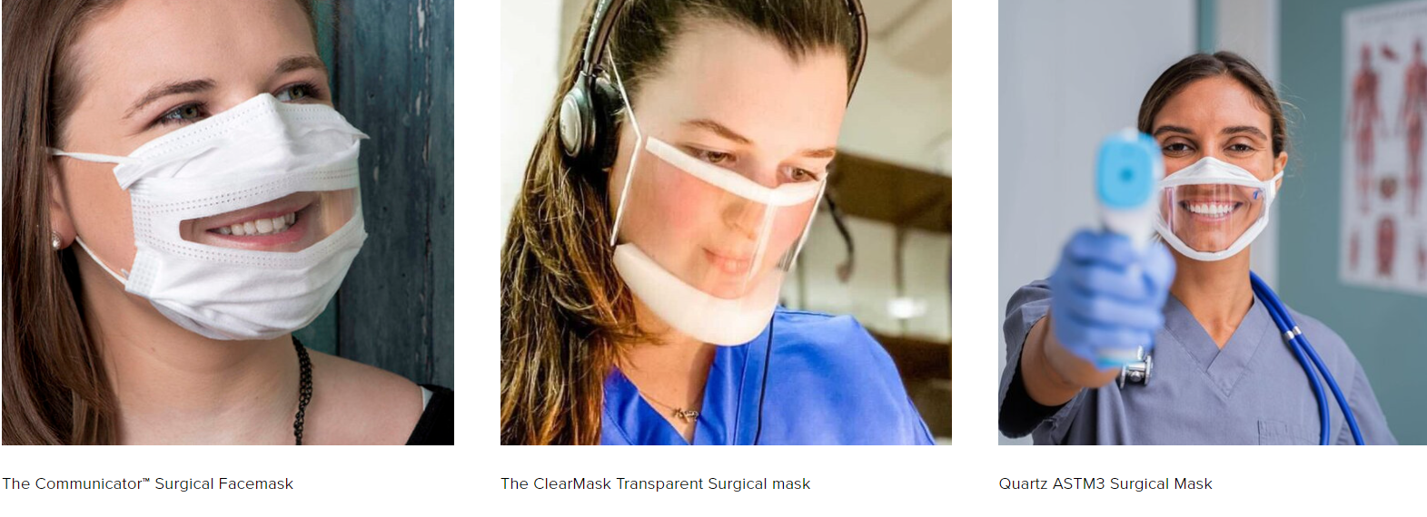
Access for DHH Healthcare Professionals
Notes:
Liz - 2 minutes
Lifeline VIEW AED device that offers visual access for cardiac emergencies: https://www.defibtech.com/products/lifeline-view-aed/
Most popular digital stethoscopes compared at https://www.amphl.org/stethoscopes
Image of Eko CORE digital stethoscope and more information: https://www.ekohealth.com/products/core-500-digital-stethoscope?variant=39999867879520
Information about digital blood pressure cuffs https://www.health.com/best-blood-pressure-monitors-6543568

Slide 16
Five Minute Break
Notes:
Bonnie – introduce break, then introduce Dyl for next slide
12:55-1:00

Slide 17
Creating an Inclusive Environment
Everyone is different – ask each individual about their communication and accommodation preferences and respect them
Inclusive communication – Slack, whiteboards, etc.
High contrast visual aids, alt-text and descriptions
Visual environment – maps in the lab, label drawers/shelves
Mental Health First Aid certification
Notes:
1:00-1:10
Dyl – 3 min
MHFA can be found via Google, have virtual and in person sessions available nationally and globally Advocacy & Sponsorship

Slide 18
Tips for Working with Access Service Providers (Interpreters and Captionists)
Before a meeting
Schedule meetings in advance so that accommodations can be requested in a timely manner
Share any meeting materials with access service providers
During a meeting
Encourage turn-taking
Give access service providers time to catch up between speakers
After the meeting
Check in to see if accommodations are working for all parties and adjust as needed
Offer to review any missed information one-on-one
Notes:
Hannah – 3 min

Slide 19
Q&A
Notes:
1:10-1:28 Questions for Q&A
Q for Carrie: what is it like as a professor working with a deaf or blind student?
Q for Dyl and for Hannah: How do you advocate for yourself? Strategies you deploy to help professors and fellow students understand when their environment is not equitable.
Bonnie can also look in the Q&A tab during the break and choose a few interesting questions from the audience.
A question that has come in in advance:
What percentage of the total population that may benefit from your team’s support, do you estimate to have helped?

Slide 20
Closing Remarks
Notes:
Shamsi
1:28-1:30

